Slide 1

WiFi-Enabled Temperature & Humidity Logger with NodeMCU and DHT22
CME 466 – Winter 2025
Prepared by: Alimul Khan, Omid Yaghoobian

Slide 2

Contents
Problem Statement
Getting Started with ESP8266
Reading data from DHT22
Connecting with Internet
IoT with Access Point[On Device IoT]
IoT with Station Mode[Local IoT]
IoT with cloud server [Cloud IoT]
1
CME 466 Internet of Things

Slide 3
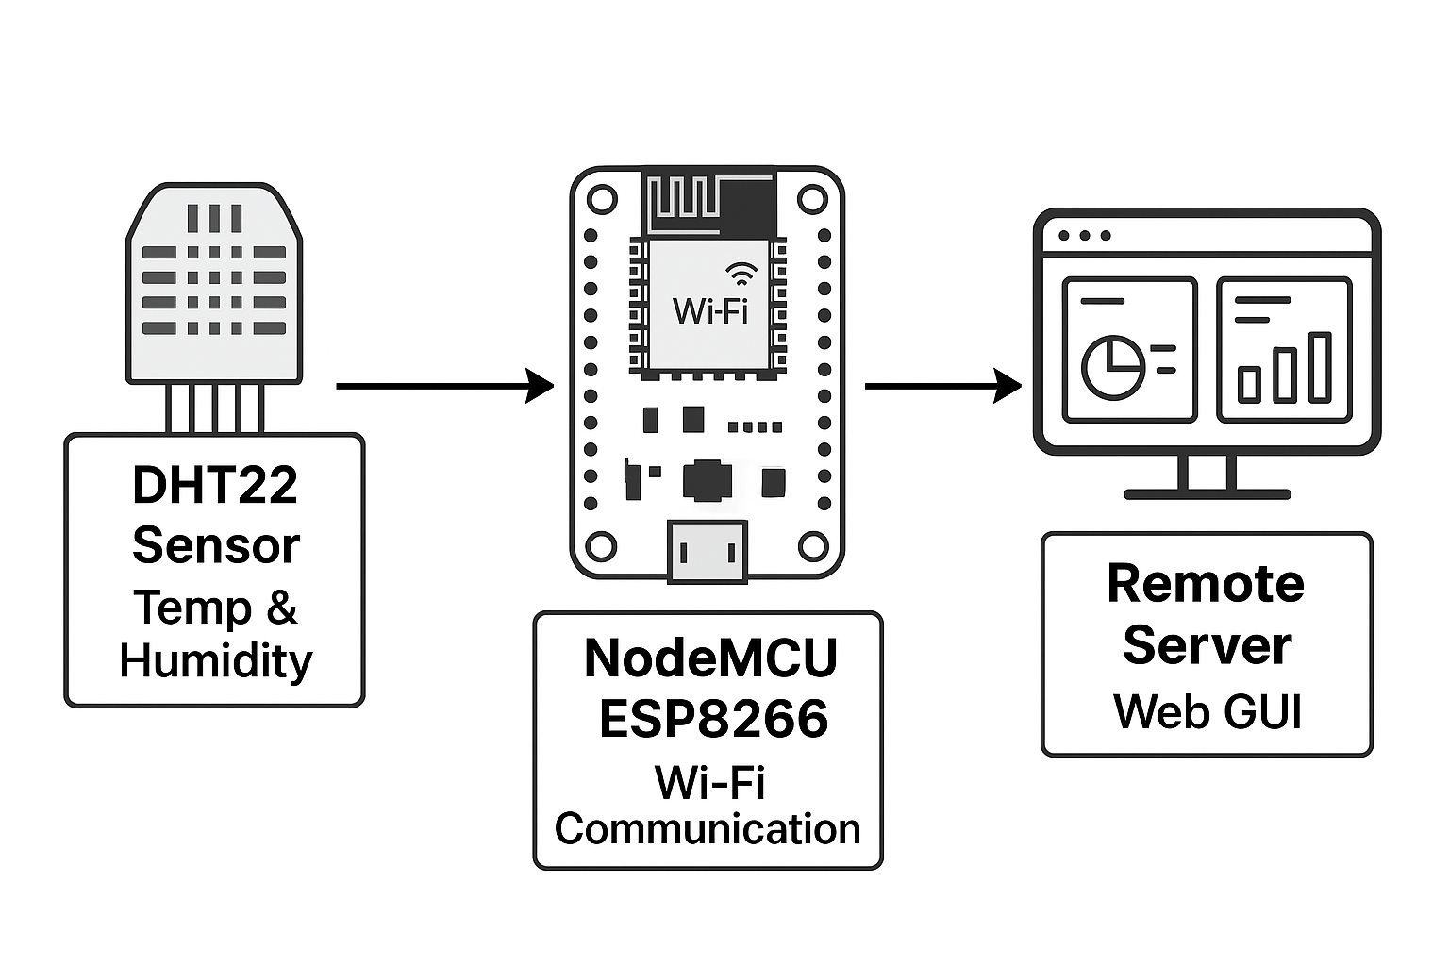
Problem Statement
This project replaces the Raspberry Pi with a Wi-Fi-enabled NodeMCU ESP8266 to collect sensor data and transmit it to servers for real-time visualization
Block Diagram
2
CME 466 Internet of Things

Slide 4
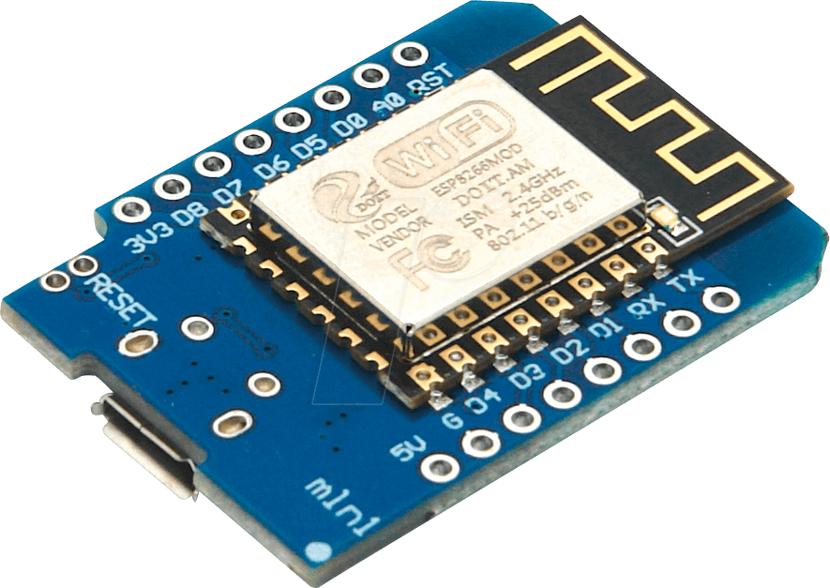
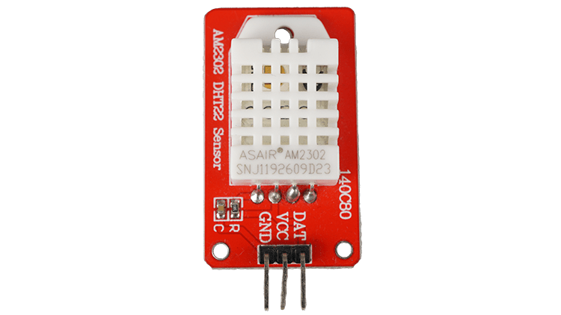



IoT Systems with ESP8266
Objective
The objective of this project is to develop an IoT system using ESP8266 and DHT22 sensor to collect temperature and humidity data, display it on the Serial Monitor, and send it to a remote server for real-time monitoring.
The project explores various communication methods and library options for efficient data handling.
NodeMCU+ DHT22
Display data on serial monitor
Communicate both way using any browser
3
CME 466 Internet of Things

Slide 5
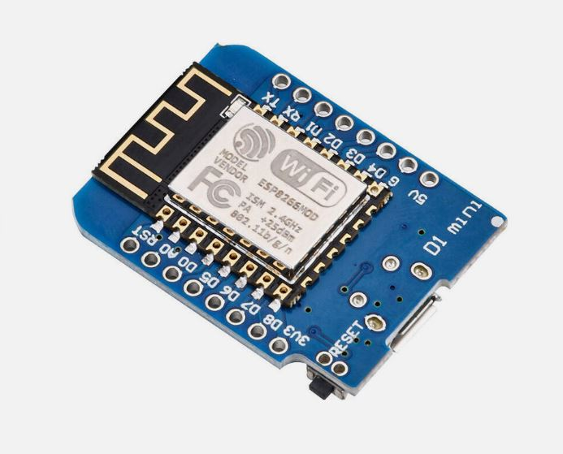
Node MCU
esp8266
Widely used microcontroller
Programmable on the shelf WiFi chip
Temperature: -40 to 80 ºC ^{+/-0.5ºC}
Humidity: 0 to 100% ^{+/-2%}
4
CME 466 Internet of Things

Slide 6
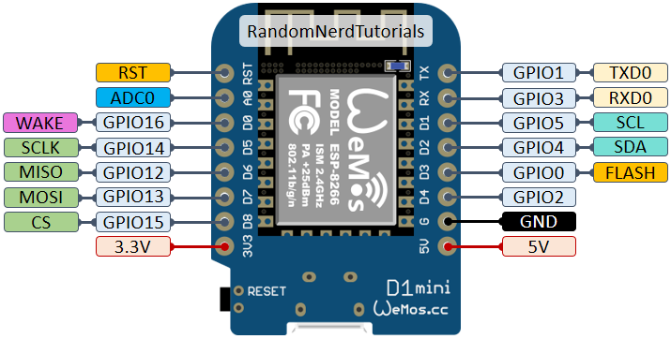
NodeMCU ESP8266 Microcontroller Pinout
5
CME 466 Internet of Things

Slide 7
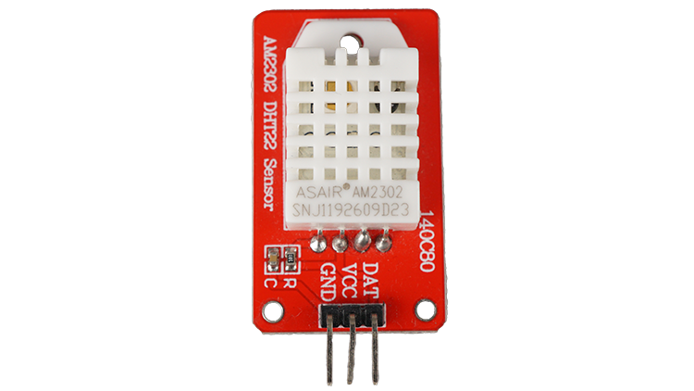
DHT22 Sensor Pinout
6
CME 466 Internet of Things

Slide 8
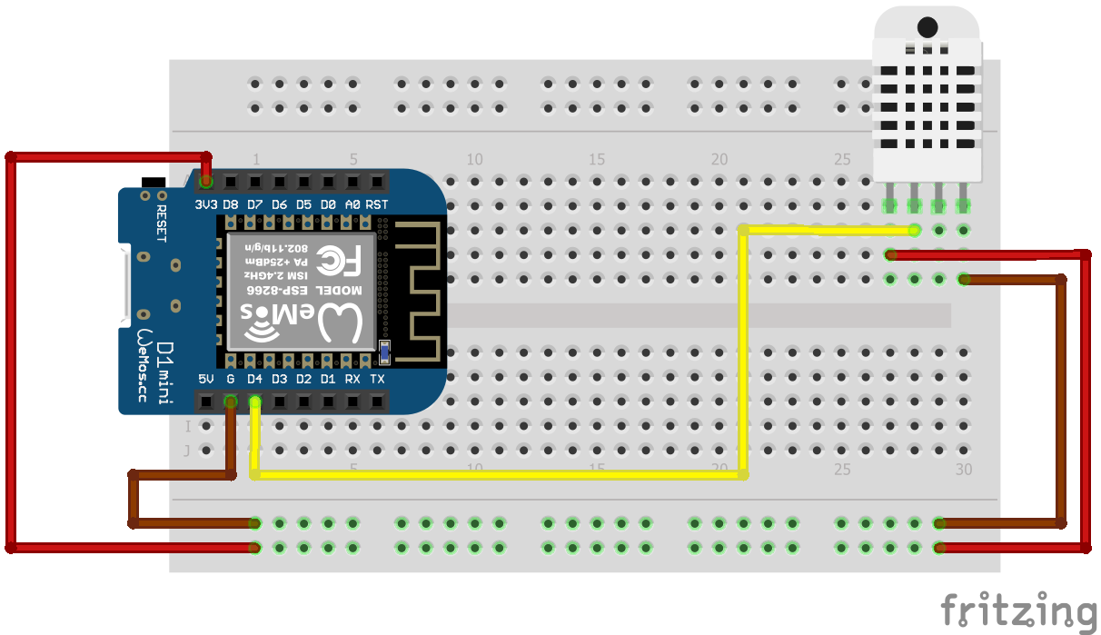
How to connect the DHT22 to the ESP8266 Microcontroller
ESP8266 Module
DHT22 Sensor
Breadboard
Jumper wires
Data
7
CME 466 Internet of Things

Slide 9
IoT Systems with ESP8266
Getting Started with ESP8266
Blink:
Go ahead with pdf provided
Just Warmup
8
CME 466 Internet of Things

Slide 10
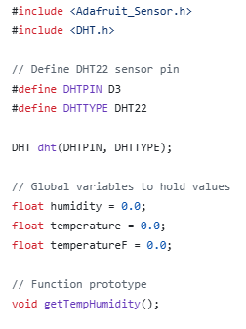
IoT Systems with ESP8266
Reading data from DHT22
Install DHT22 library
Use this example to see sensor data at the serial terminal
See its library examples for more details
Include libraries
Define pins and sensor types
Initialization of DHT variable
Initialization of temperature and humidity
9
CME 466 Internet of Things

Slide 11
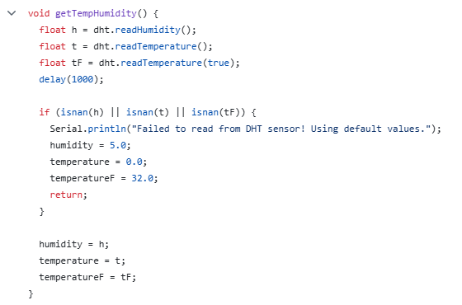
IoT Systems with ESP8266
Reading data from DHT22
Reading sensor data
For testing only:
If the DHT22 sensor is not connected, the code will send fake (hardcoded) sensor data.
‘isnan’ function is used to check if the received string is not a number.
10
CME 466 Internet of Things

Slide 12
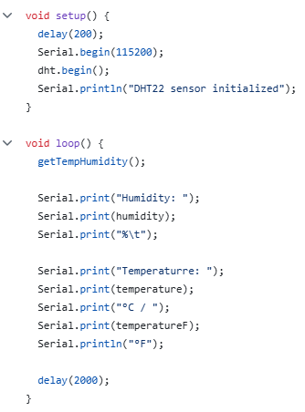
IoT Systems with ESP8266
Reading data from DHT22
Initialized serial communication and dht22 sensor. Make sure the baud rate is same as Serial.begin(115200);
Reading the temperature by calling getTempHumidity();
Sending formatted data over serial communication
11
CME 466 Internet of Things

Slide 13
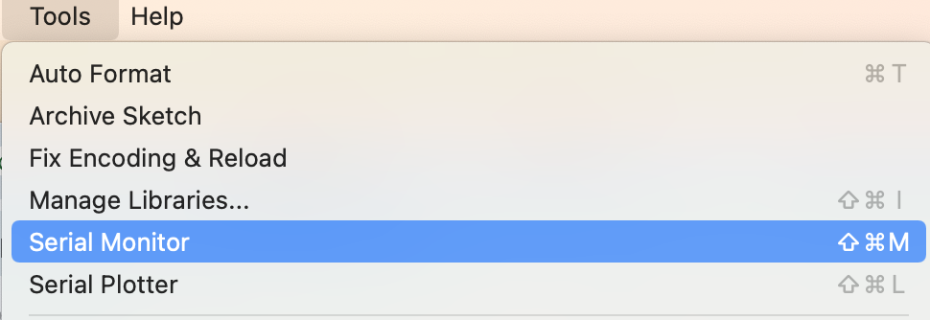
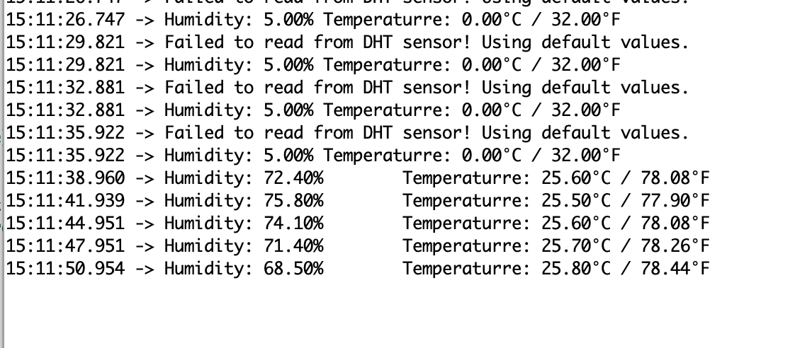
IoT Systems with ESP8266
Reading data from DHT22
espDHT22
Open the serial terminal.
Ensure the correct baud rate is selected.
Try reconnecting the sensor if the reading fails.
12
CME 466 Internet of Things

Slide 14
IoT Systems with ESP8266
ESP internet Connection Modes
Most Common Modes:
Access Point (AP) Mode: The ESP creates its own Wi-Fi network, allowing other devices to connect.
Station (STA) Mode: The ESP connects to an existing Wi-Fi network as a client.
Cloud Mode: The ESP connects to a cloud server over the internet for remote access and data exchange.
13
CME 466 Internet of Things

Slide 15
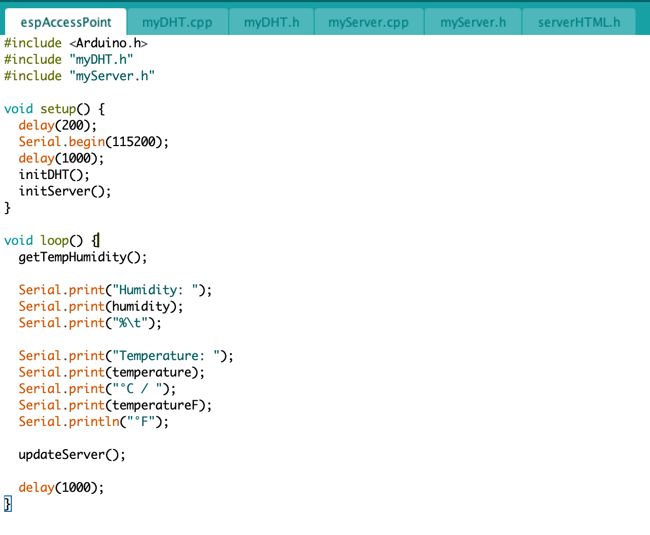
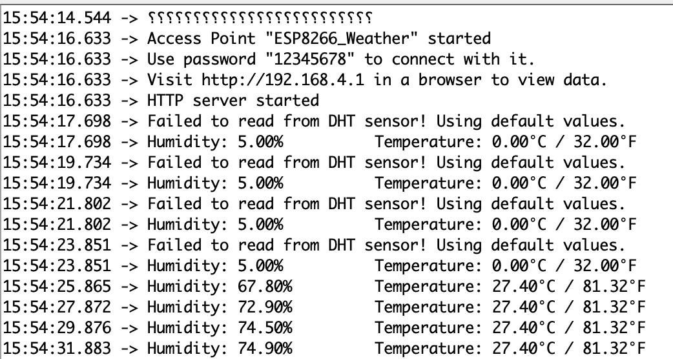
IoT Systems with ESP8266
ESP Access Point
Organizing Code with Modules:
The whole code is modularized into multiple .h and .cpp files alongside main.ino for better organization and maintainability.
14
CME 466 Internet of Things

Slide 16
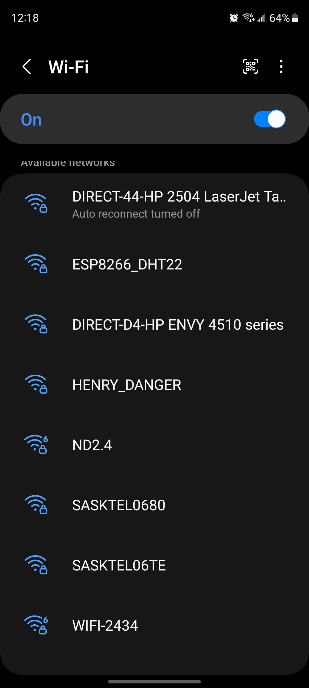
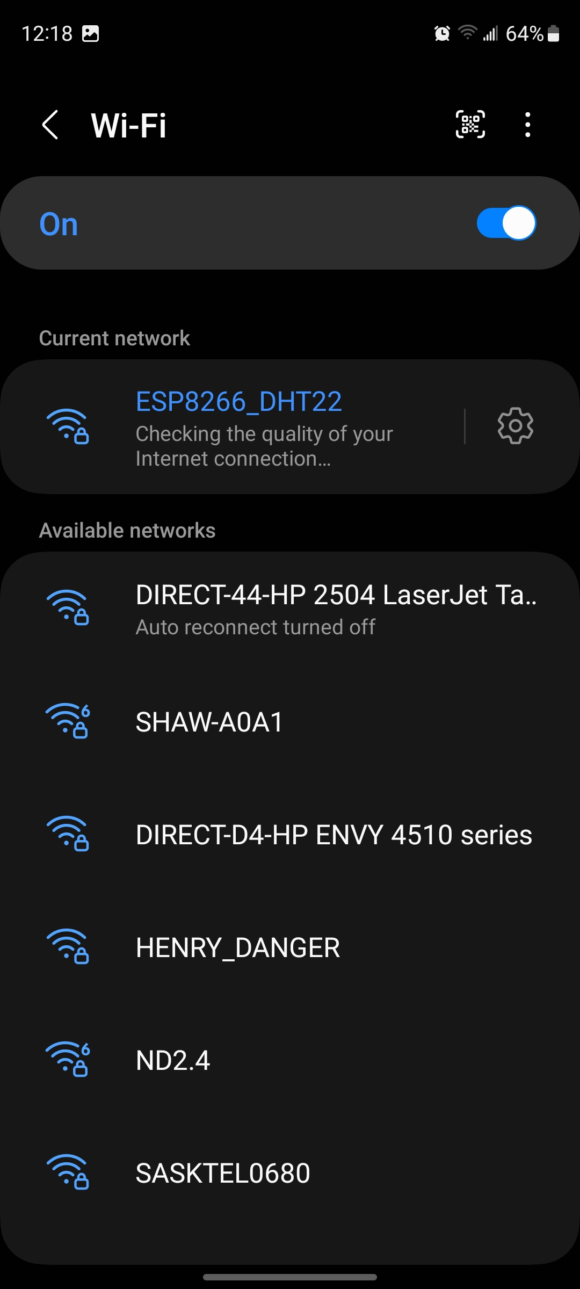
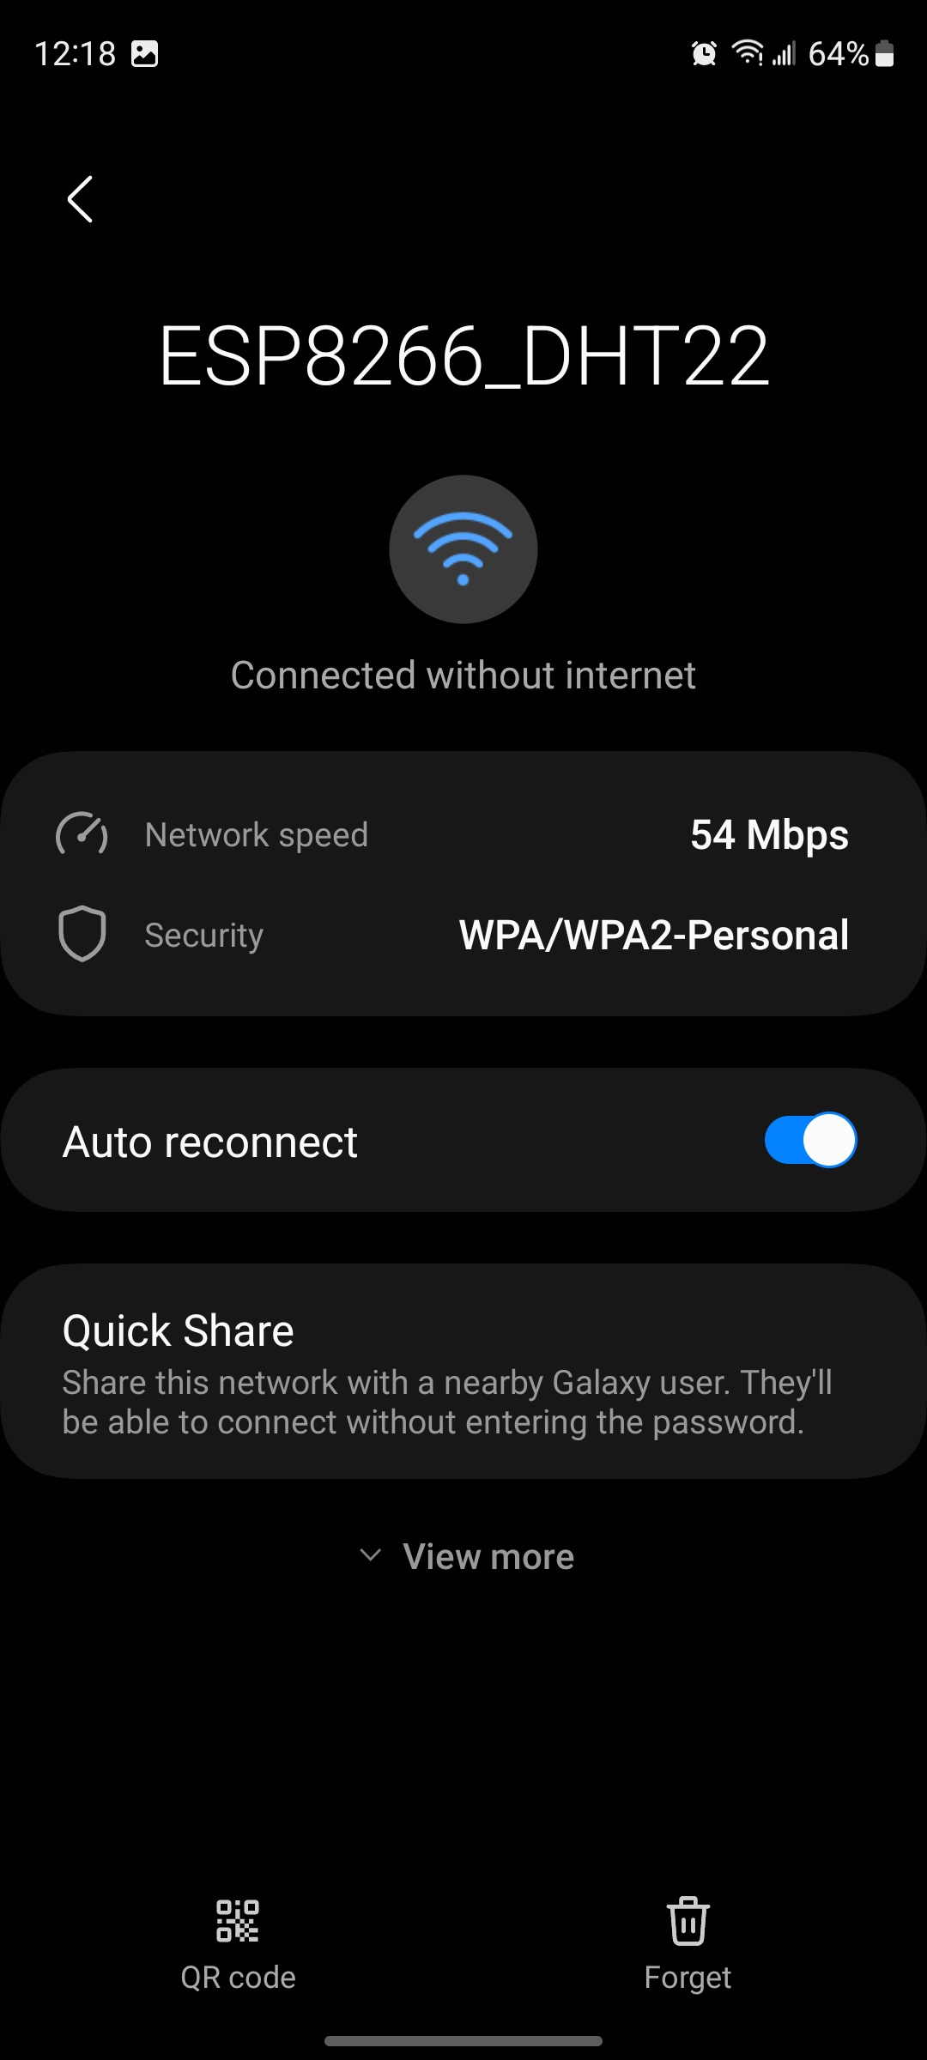
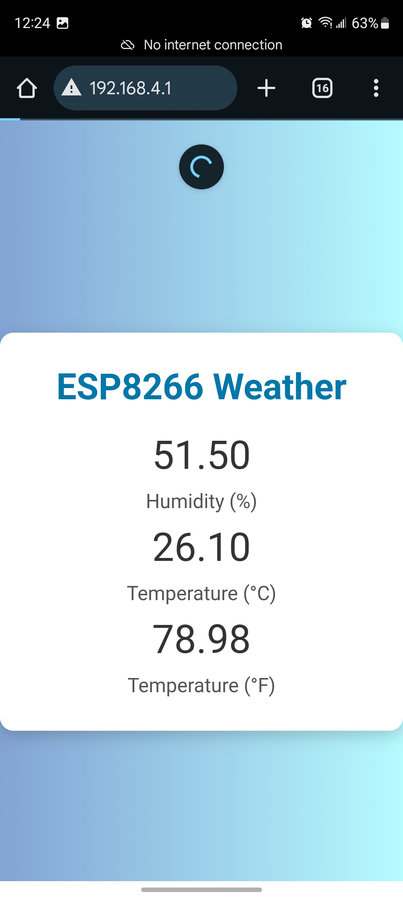
IoT Systems with ESP8266
ESP Access Point
Use a specific SSID and password to connect to the Access Point, then browse to 192.168.4.1.
15
CME 466 Internet of Things

Slide 17
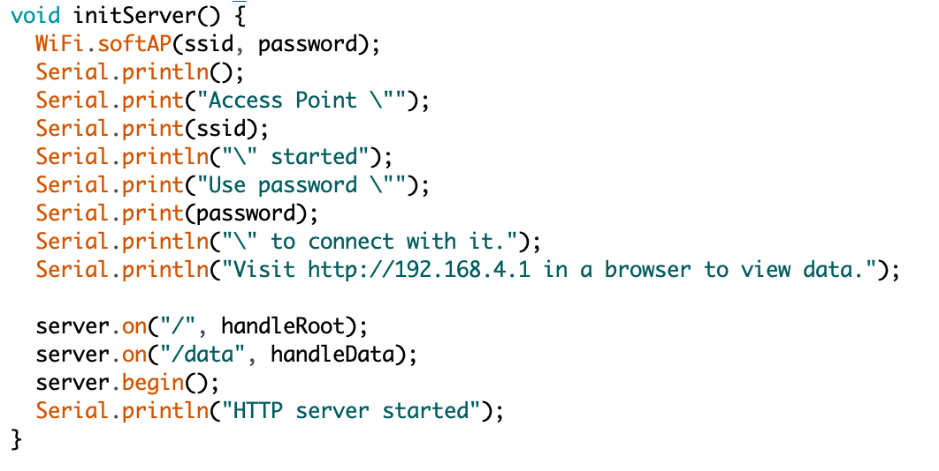
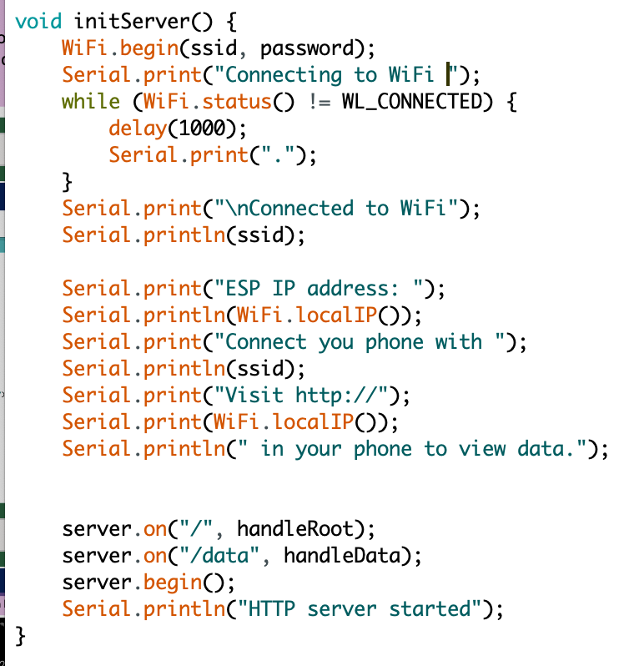
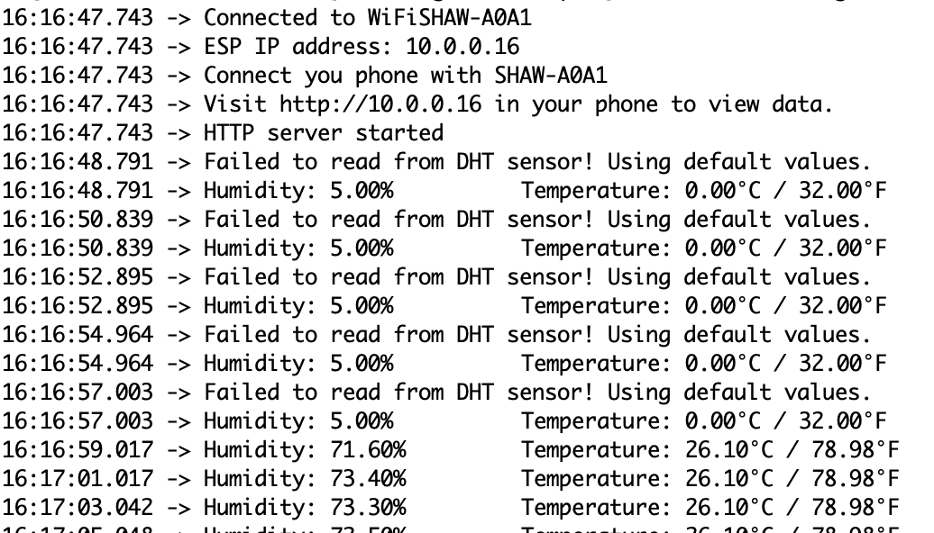
IoT Systems with ESP8266
ESP Station Mode
Access Point Mode
Station Mode
AP mode:
WiFi.softAP(ssid, password);
Station Mode:
WiFi.begin(ssid, password);
Serial.print("Connecting to WiFi ");
while (WiFi.status() != WL_CONNECTED) {
delay(1000);
Serial.print(".");
}
16
CME 466 Internet of Things

Slide 18
IoT Systems with ESP8266
ESP cloud more
This project uses an ESP8266 with a DHT22 sensor to measure temperature and humidity, with a Python Flask-based server on a computer acting as the cloud. Users access their node using a unique chip ID, and data is sent only upon request for efficient, on-demand communication.
Key features:
Node sends data only when requested by the user.
Data transmission is triggered upon receiving a valid request.
Users can view real-time sensor data through the web interface.
Reduces unnecessary data transfer and conserves bandwidth.
17
CME 466 Internet of Things

Slide 19
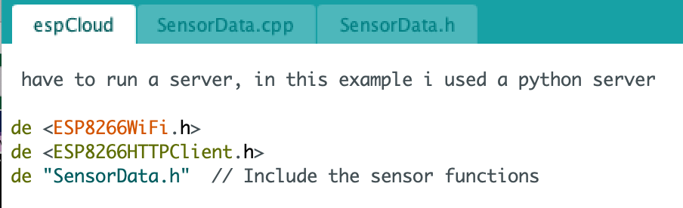
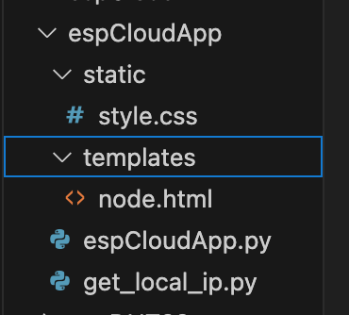
IoT Systems with ESP8266
ESP cloud more
esp part
Server part
There are three files in this directory
There are four files in this directory
espCloud.ino
get_local_ip.py
SensorData.h
espCloudApp.py
SensorData.cpp
templates/node.html
static/style.css
18
CME 466 Internet of Things

Slide 20
IoT Systems with ESP8266
ESP cloud more
1. Run “get_local_ip.py” and get your IP in the terminal, let say it is 10.0.0.181
2. Replace serverIP here in espCloud.ino:
const char* serverIP = "10.0.0.181";
3. Connect HW with computer and load Arduino code
4. Note the link you are supposed to browse along with chip ID from the serial terminal: http://127.0.0.1:5000/node/chipID or http://10.0.0.181:5000/node/chipID
5. Run espCloudApp.py
6. Browse from a device on same network: http://127.0.0.1:5000/node/chipID
7. Send Desired command to get data from your sensor
19
CME 466 Internet of Things

Slide 21
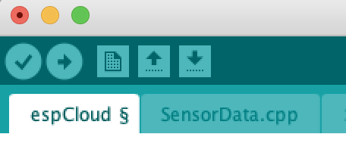
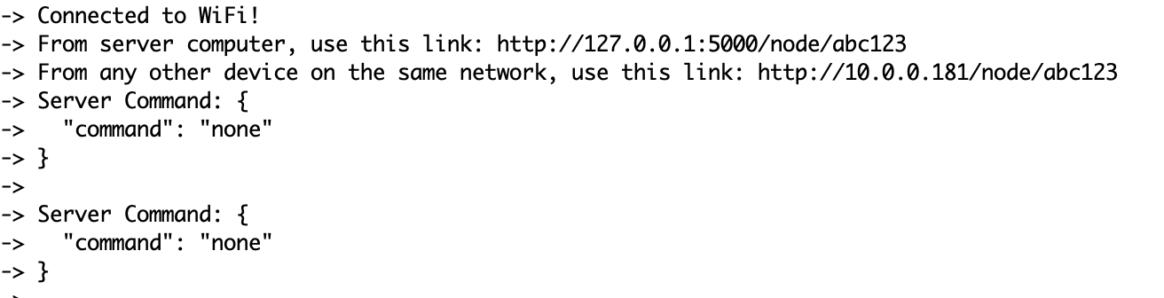
IoT Systems with ESP8266
ESP cloud more
Run get_local_ip.py
Replace IP in *.ino
Upload firmware
Find the link
20
CME 466 Internet of Things

Slide 22


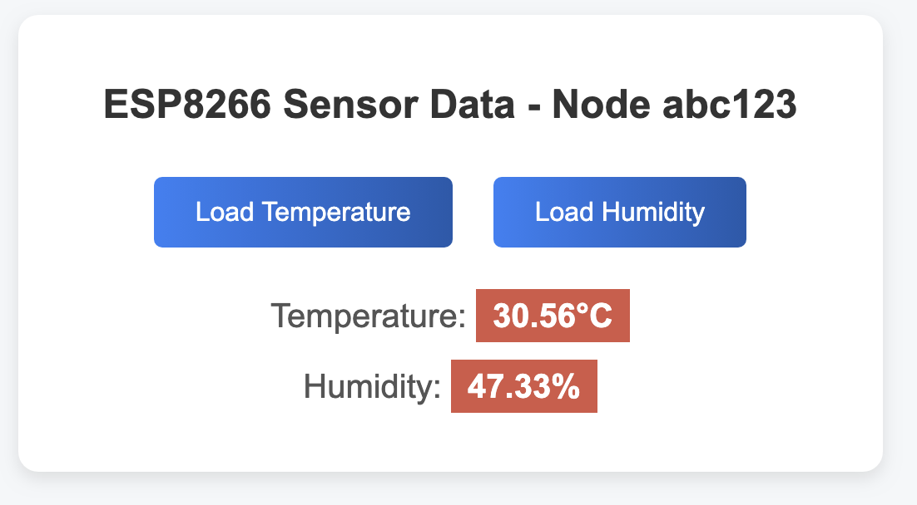
IoT Systems with ESP8266
ESP cloud more
Browse Now
or
21
CME 466 Internet of Things

